Slide 1

Tableau
Basic to advance for all

Slide 2
Introduction to Tableau
What is Tableau and why Tableau?
Tableau Architecture
Tableau Products
https://www.tableau.com/products/public/download
https://www.guru99.com/what-is-tableau.html
https://www.guru99.com/download-install-tableau.html
https://www.guru99.com/tableau-vs-power-bi-difference.html
https://www.guru99.com/tableau-data-connections.html
https://www.guru99.com/tableau-charts-graphs-tutorial.html
https://www.geeksforgeeks.org/data-blending-in-tableau/

Slide 3
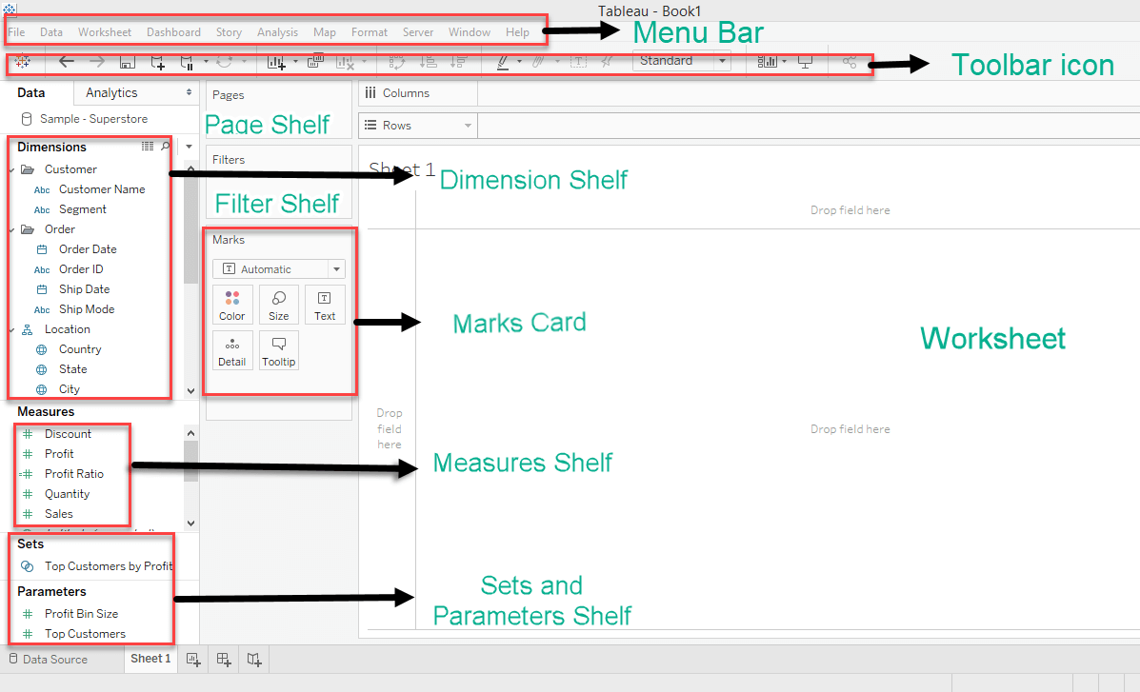

Slide 4
Menu Bar:
It consists of menu options such as File, Data, Worksheet, Dashboard, Story, Analysis, Map, Format, Server, and Windows. The options in the menu bar include features such as file saving, data source connection, file export, table calculation options, and design features for creating a worksheet, dashboard, and storyboard.
Toolbar Icon:
Toolbar icon present below the menu bar can be used to edit the workbook using different features such as undo, redo, save, new data source, slideshow and so on.
Dimension Shelf:
The dimensions present in the data source can be viewed in the dimension shelf.
Measure Shelf:
The measures present in the data source can be viewed on the measure shelf.
Sets and Parameters Shelf:
The user-defined sets and parameters can be viewed in the sets and parameter shelf. It can also be used to edit the existing sets and parameters.
Page Shelf:
Page shelf can be used to view the visualization in video format by keeping the relevant filter on the page shelf.
Filter Shelf:
The filters that can control the visualization can be placed on the filter shelf, and the required dimensions or measures can be filtered in.
Marks Card:
Marks card can be used to design the visualization. The data components of the visualization such as color, size, shape, path, label, and tooltip used in the visualizations can be modified in the marks card.
Worksheet: https://www.guru99.com/download-install-tableau.html

Slide 5
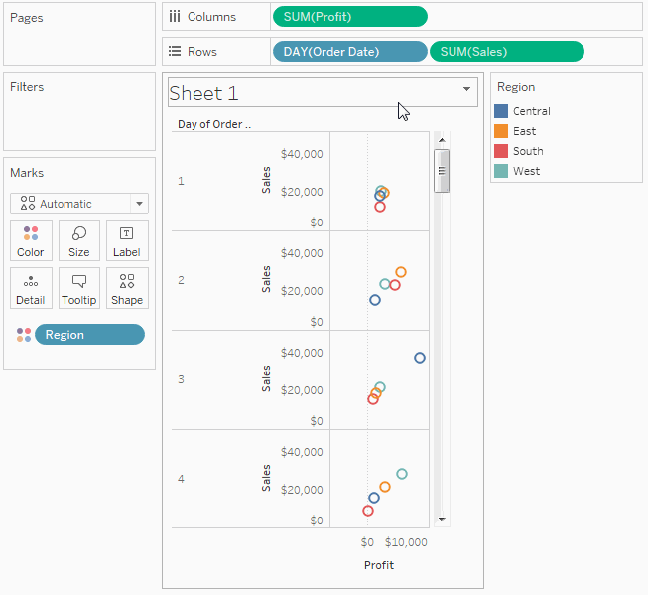
Pages shelf
The Pages shelf lets you break a view into a series of pages so you can better analyze how a specific field affects the rest of the data in a view. When you place a dimension on the Pages shelf you are adding a new row for each member in the dimension. When you place a measure on the Pages shelf, Tableau automatically converts the measure into a discrete measure.
https://help.tableau.com/current/pro/desktop/en-us/buildmanual_shelves.htm
https://www.tutorialspoint.com/tableau/tableau_paged_workbook.htm

Slide 6
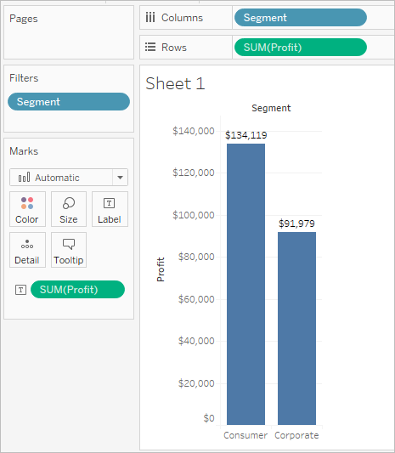
Filters shelf
The Filters shelf allows you to specify which data to include and exclude.
For example
Suppose you are not interested in the Home Office data. You can remove this column from the view by filtering the Segment dimension. To do so, select Filter on the field menu or drag the Segment dimension to the Filters shelf.
https://help.tableau.com/current/pro/desktop/en-us/buildmanual_shelves.htm

Slide 7
Data Types in Tableau
Tableau Data Types :- Measures & Dimensions
Tableau classifies data into two primary types: Measures and Dimensions.
Measures
Definition: Measures are quantitative data fields that can be aggregated. They are typically numeric and can be used in calculations.
Examples: Sales, Profit, Quantity, Discount.
Behavior: Measures are aggregated automatically (e.g., summed, averaged) when placed on the Rows or Columns shelves.
Dimensions
Definition: Dimensions are categorical data fields that are used to segment and group data. They provide context to the measures.
Examples: Category, Region, Product Name, Customer ID.
Behavior: Dimensions are used to create the structure of the view, affecting how measures are aggregated.

Slide 8
2. Discrete vs. Continuous
Understanding the difference between discrete and continuous data is crucial in Tableau.
Discrete
Definition: Discrete data consists of distinct and separate values. It often represents categories or counts.
Characteristics:
Shown in distinct, separate colors or shapes.
Can be used for grouping and filtering.
Example: Region, Category, Order ID.
Continuous
Definition: Continuous data represents a range of values and can take on any value within a given range.
Characteristics:
Shown as a gradient or a continuous axis.
Often used for trends and distributions.
Example: Sales, Profit, Order Date.

Slide 9
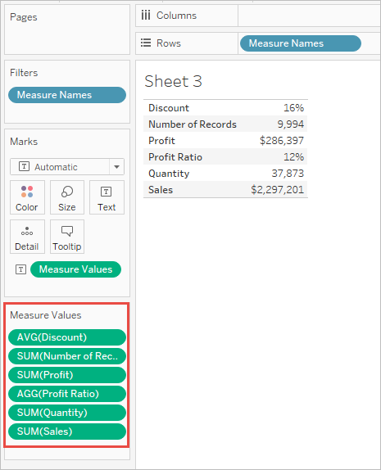
3. Measure Names and Measure Values
Measure Names: This field contains the names of all measures in your data source. You can use it to display multiple measures in a single visualization.
Measure Values: This field contains the actual values of the measures you want to display. You can use it to create visualizations that show multiple measures on the same axis.
Usage: By dragging both onto the view, you can create a combined chart that allows comparison across measures (e.g., Sales and Profit in a single bar chart).
https://help.tableau.com/current/pro/desktop/en-us/datafields_understanddatawindow_meavalues.htm

Slide 10
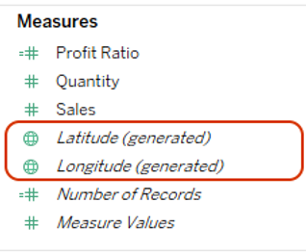
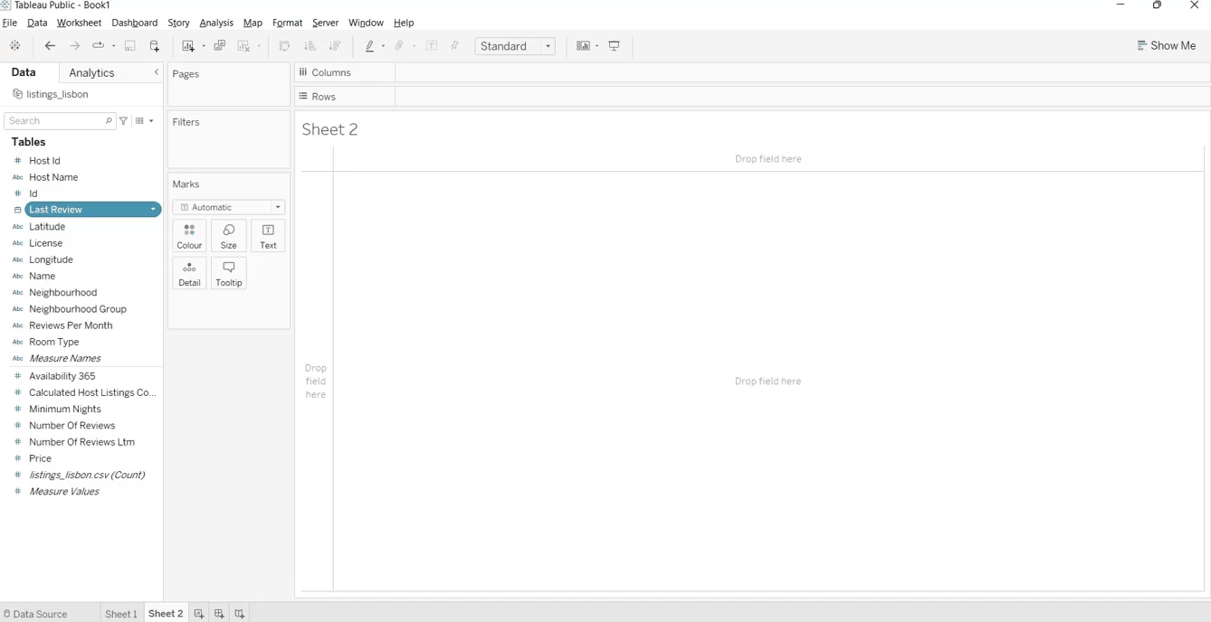
4. Generated Fields
Tableau also allows users to create custom fields to enhance analysis.
Latitude (generated) & Longitude (generated)
Anytime you assign a geographic role to a field, Tableau adds two fields on the measure area namely; Latitude (generated) and Longitude (generated).
These fields contain the latitude and longitude values and are assigned the Latitude and Longitude geographic roles. Used to create a map view.
1. Calculated Fields
Definition: Calculated fields are user-defined fields created using formulas and expressions.
Usage: They can perform calculations based on existing data, allowing for more complex analysis.
Example: A calculated field for profit ratio could be created using the formula
https://www.rigordatasolutions.com/post/tableau-generated-fields

Slide 11
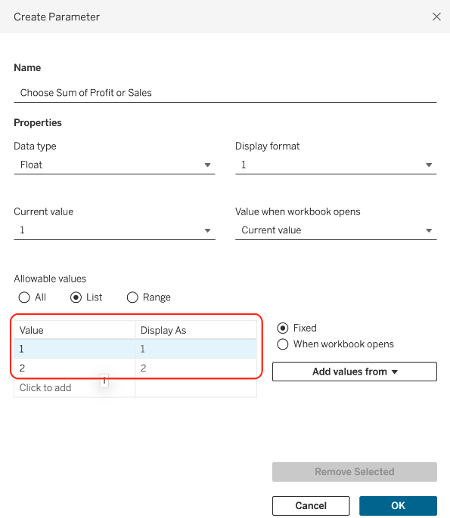
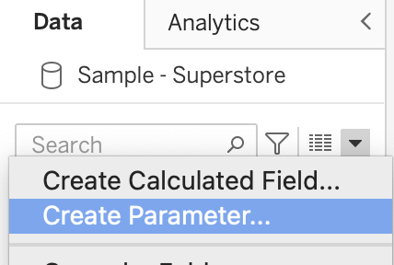
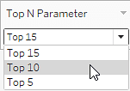
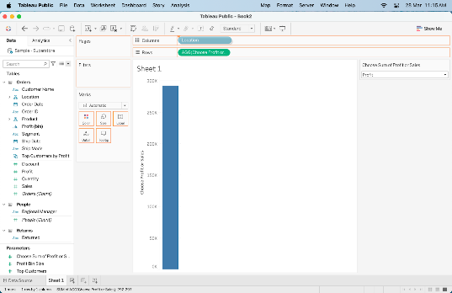
2. Parameters
Definition: Parameters are dynamic values that can replace a constant value in calculations, filters, or reference lines.
Usage: They allow users to interactively change values in visualizations without modifying the underlying data.
Example: A parameter to select a specific discount rate that could be used in a calculated field to adjust profit calculations based on user input.
https://www.simplilearn.com/tutorials/tableau-tutorial/parameters-in-tableau
https://help.tableau.com/current/pro/desktop/en-us/parameters_create.htm

Slide 12
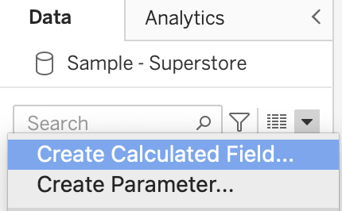
Parameters vs Filters: What's the Difference?
Filters are used to limit the data that is included in a visualization. For example, you may filter your data only to show sales from a certain region or time period.
Parameters, on the other hand, allow users to dynamically change certain aspects of a visualization, such as the color scheme or the level of detail shown.
While filters are fixed and set before a visualization is created, parameters can be changed on the fly while viewing the data.
Even though parameters and filters can control what data is shown in your visualizations, they work differently.
https://www.datacamp.com/tutorial/tableau-parameters-an-introductory-guide-and-how-to-use-them

Slide 13
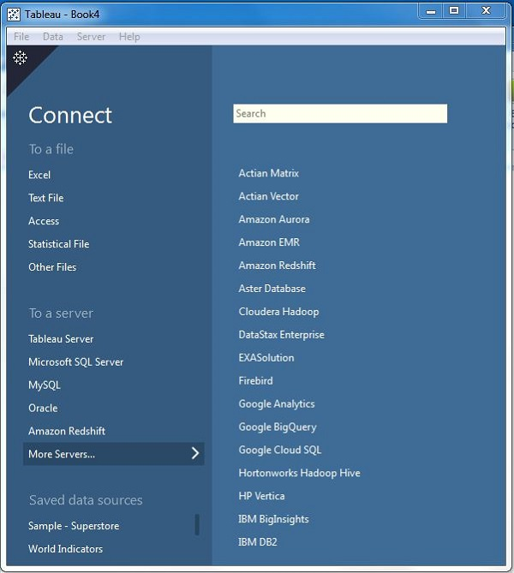
Connecting to and Preparing
Data
Types of Connection-Data extracts vs. live connections
Connecting to different file formats excel,csv,sql server
How to connect Multiple Data Source - Join, Cross Database Join ,Data Blending,Union

Slide 14
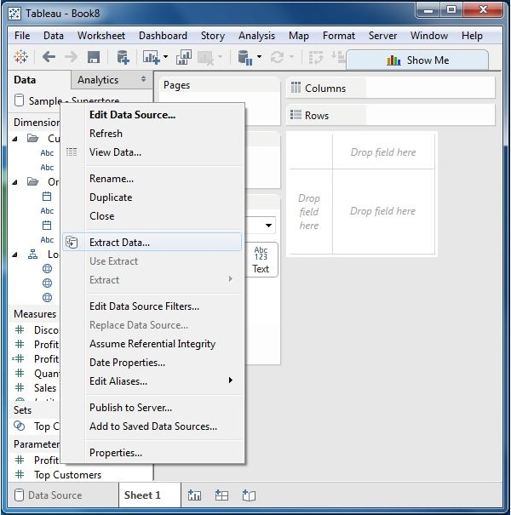
Extraction of data is done by following the menu - Data → Extract Data.
Types of Connections
Data Extracts
Definition: A data extract is a snapshot of data optimized for performance. It stores a subset of the data in Tableau’s proprietary format.
Advantages:
Faster performance and loading times, especially with large datasets.
Offline access to the data.
Ability to aggregate and summarize data for faster analysis.
Usage: Best for scenarios where data does not change frequently or where performance is a priority.
https://www.tutorialspoint.com/tableau/tableau_extracting_data.htm

Slide 15
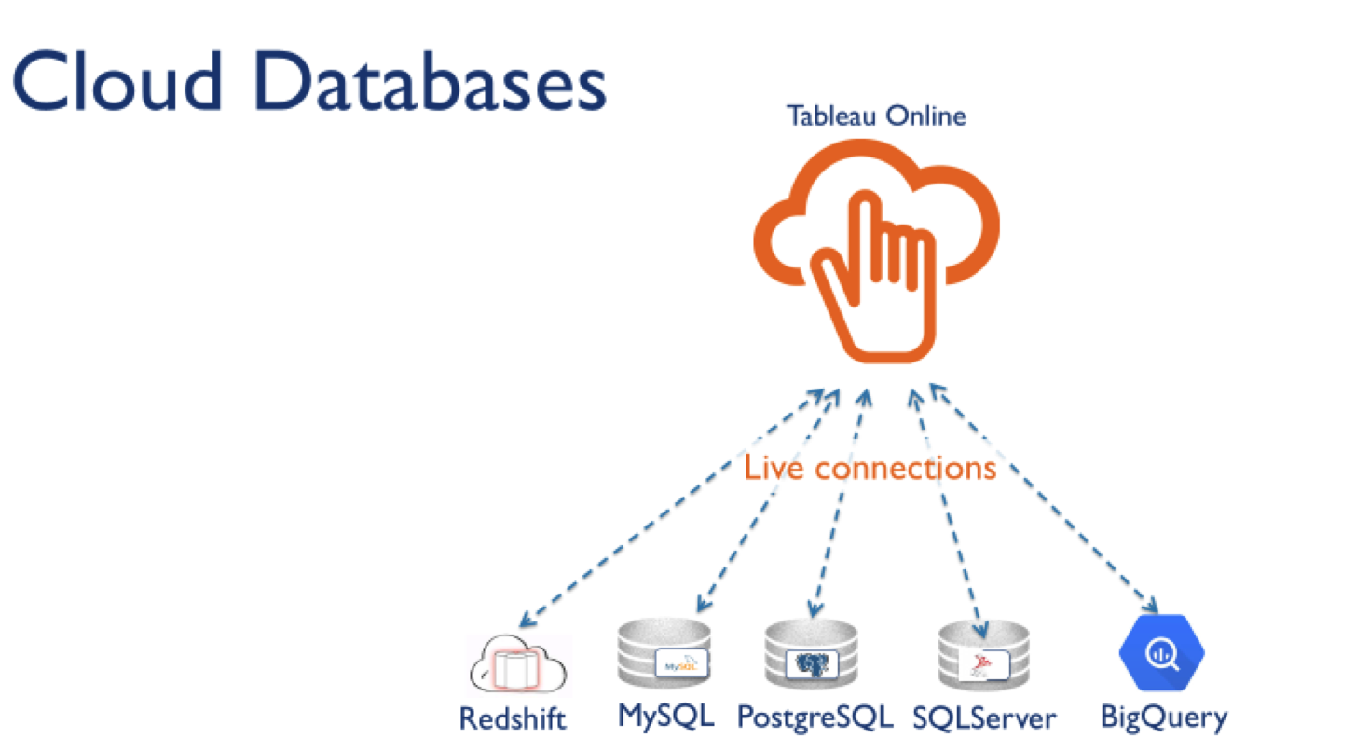
2. Live Connections
Definition: A live connection connects directly to the data source, reflecting real-time changes.
Advantages:
Always up-to-date with the latest data.
Useful for data that changes frequently and requires real-time analysis.
Usage: Ideal when you need to work with the most current data, such as in operational dashboards.
https://www.tableau.com/blog/tableau-cloud-tips-extracts-live-connections-cloud-data

Slide 16
Connecting to Different File Formats
Excel
Process:
In Tableau, select "Connect to Data" and choose "Microsoft Excel."
Browse and select your Excel file.
You can then choose the specific sheets to import.
CSV
Process:
Similar to Excel, choose "Text File" in the connection options.
Navigate to your CSV file and select it for import.
SQL Server
Process:
Select "Microsoft SQL Server" under the connection options.
Enter the server name, database, and authentication details.
You can then select tables or views from the database.
https://docs.devart.com/odbc/sqlserver/tableau.htm
https://youtu.be/kuDgfwGTeuY?si=A2oARyCCDS0cIe-H

Slide 17
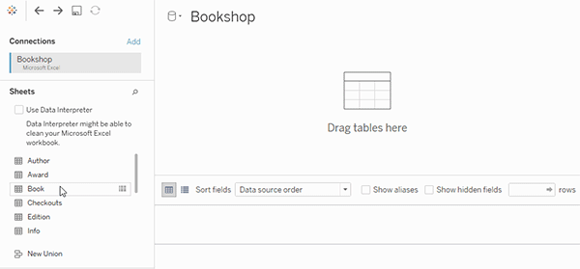
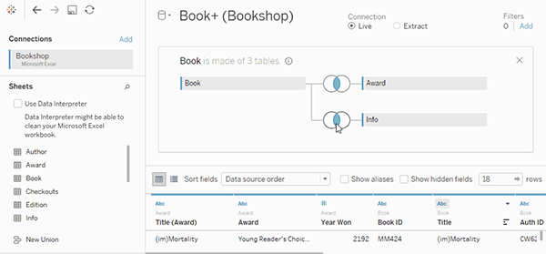
Connecting Multiple Data Sources
Joins
Definition: Joins combine tables from the same data source based on a common field (key).
Types:
Inner Join: Returns only matching records from both tables.
Left Join: Returns all records from the left table and matched records from the right.
Right Join: Returns all records from the right table and matched records from the left.
Full Outer Join: Returns all records when there is a match in either left or right table.
https://help.tableau.com/current/pro/desktop/en-us/joining_tables.htm

Slide 18
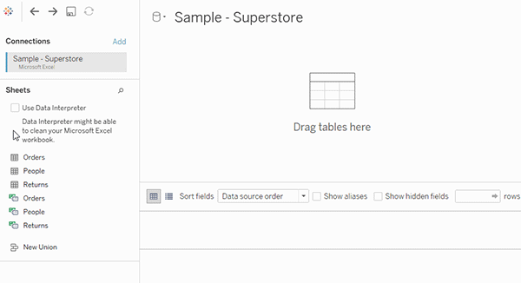
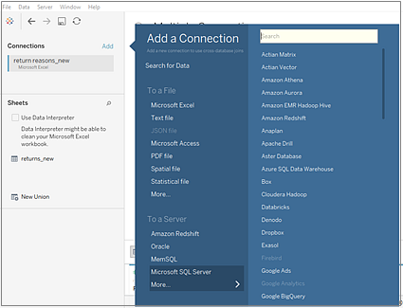
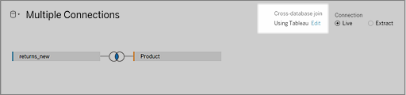
2. Cross Database Join
Definition: Allows you to join tables from different databases within the same Tableau workbook.
Process: In the Data pane, select a second data source and drag a table to the first data source, allowing you to define join conditions.
The Cross-database join option is displayed.
https://help.tableau.com/current/pro/desktop/en-us/joins_xbd_perf.htm

Slide 19
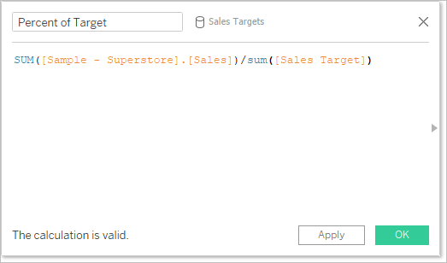
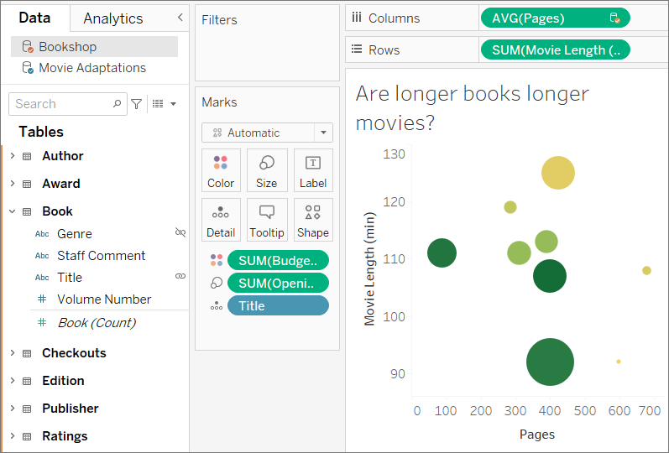
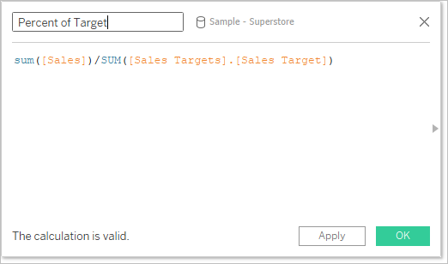
3. Data Blending
Definition: A method for combining data from different sources without needing to create joins.
Process:
Connect to different data sources.
Use a common dimension (like Customer ID) to blend the data.
Tableau will create a primary data source (usually the first one added) and a secondary data source, using a link icon to indicate blending.
Note: Blending is often used when the data sources cannot be joined directly.
Understand primary and secondary data sources
Differences between joins and data blending
Data blending simulates a traditional left join. The main difference between the two is when the aggregation is performed. A join combines the data and then aggregates. A blend aggregates and then combines the data.
https://help.tableau.com/current/pro/desktop/en-us/multiple_connections.htm

Slide 20
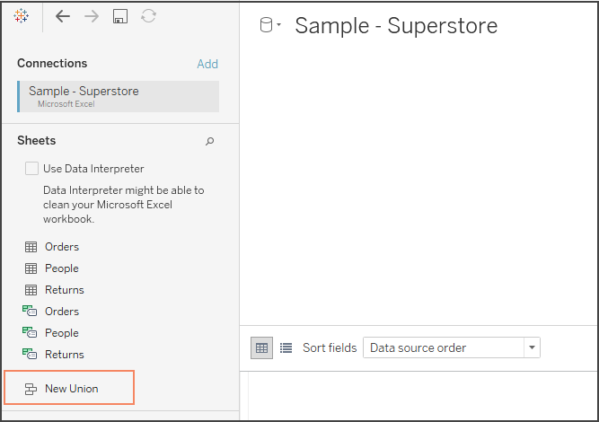
4. Union
Definition: A union combines data from multiple tables with the same structure (same number of columns and data types).
Process:
In the data connection window, drag one table over another in the same data source.
Choose "Union" and select additional tables to include in the union.
Use Case: Useful when you have multiple datasets (like sales data from different regions) that share the same columns.
https://help.tableau.com/current/pro/desktop/en-us/union.htm

Slide 21
Summary
Data Extracts vs. Live Connections: Choose extracts for performance and offline access; live connections for real-time data.
File Formats: Tableau supports various formats, including Excel, CSV, and SQL Server.
Combining Data Sources: Use joins for related tables, cross-database joins for different databases, data blending for unrelated sources, and unions for similar structures.
These features make Tableau a powerful tool for data analysis and visualization!

Slide 22
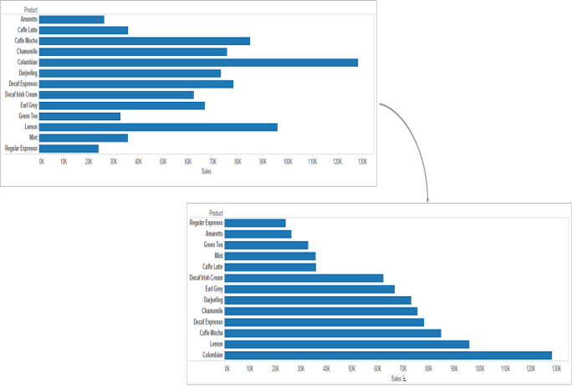
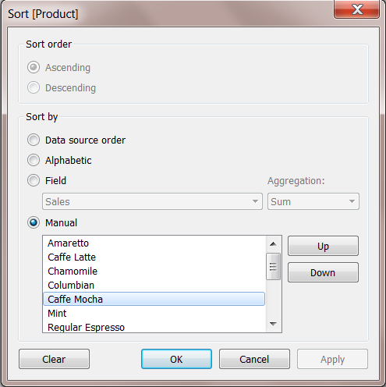
Organizing and Simplify Data
Sort Data
Types of Filters
Building Groups ,Sets ,Hierarchies
1. Sorting Data
Definition: Sorting allows you to arrange data in a specific order (ascending or descending) based on one or more fields.
How to Sort:
Sort in a Visualization: Click on the field in the Rows or Columns shelf and select the sort icon (ascending or descending).
Sort Dialog: Right-click a dimension or measure in the Data pane, select "Sort," and specify your sorting preferences (by field, manual order, etc.).
Use Case: Sorting is useful for displaying top or bottom performers (e.g., top 10 products by sales) or organizing categories in a meaningful way.
https://help.tableau.com/current/reader/desktop/en-us/reader_sort.htm

Slide 23
2. Types of Filters
Filters allow you to limit the data displayed in your visualizations. Here are the main types:
Dimension Filters
Definition: Filters applied to categorical fields (dimensions).
Usage: Used to include/exclude specific categories (e.g., filtering to show only certain regions).
Measure Filters
Definition: Filters applied to quantitative fields (measures).
Usage: Used to set thresholds (e.g., showing only sales greater than $10,000).
Context Filters https://www.tutorialspoint.com/tableau/tableau_context_filters.htm
Definition: Filters that establish a context for other filters.
Usage: Once a context filter is applied, other filters are processed in relation to it (e.g., filtering to a specific year before applying product filters).
Top N Filters
Definition: Filters that show only the top or bottom N items based on a measure.
Usage: Useful for quickly identifying top products or regions by sales or profit.
Relative Date Filters
Definition: Filters that limit data to a specific time period (e.g., last 7 days, last quarter).
Usage: Useful for time-sensitive analysis.
Extract filters, Data source filters, Table calculation filter, Wildcard filter, Filter action

Slide 24
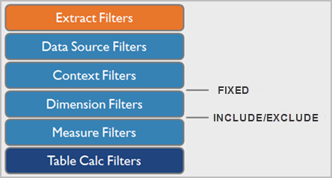

Slide 25
1. Extract Filters: Applied when creating an extract from a data source, these filters remove data that is not needed for the analysis, improving performance.
2. Data Source Filters: These filters are applied at the data source level and are used to restrict the data that is brought into Tableau before any other filters are applied.
3. Context Filters: These filters are applied to the data table before any other filters, effectively defining a subset of data for the analysis.
4. Dimension Filters: These filters allow you to select or exclude specific values within a dimension (e.g., regions, categories).
5. Measure Filters: These filters are used to filter based on the values of measures (e.g., sales, profit).
6. Table Calculation Filters: These filters are applied after all other filters and allow you to filter data based on the results of table calculations.

Slide 26
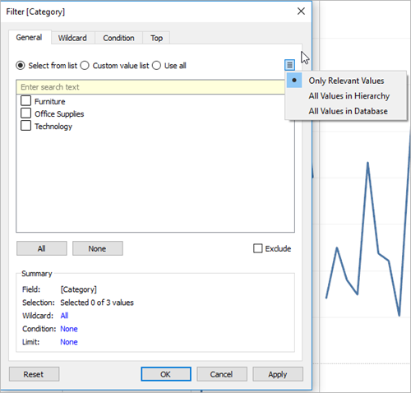
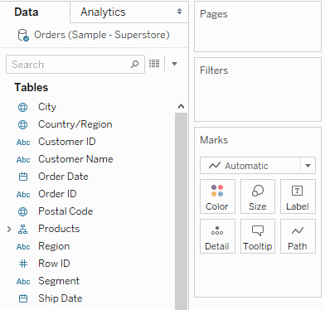
https://www.javatpoint.com/tableau-condition-filters
https://help.tableau.com/current/pro/desktop/en-us/filtering.htm
https://help.tableau.com/current/pro/desktop/en-us/filtering_context.htm
https://help.tableau.com/current/pro/desktop/en-us/order_of_operations.htm

Slide 27
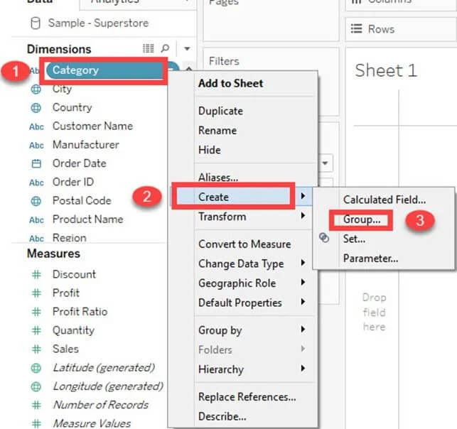
3. Building Groups, Sets, and Hierarchies
Groups
Definition: Groups combine multiple dimension members into a single category for simplified analysis.
How to Create a Group:
Select members in the Data pane or visualization, right-click, and choose "Group."
Use Case: For instance, you might group certain sub-categories into an "Electronics" category for easier reporting.
https://hevodata.com/learn/tableau-groups/ Steps follow

Slide 28
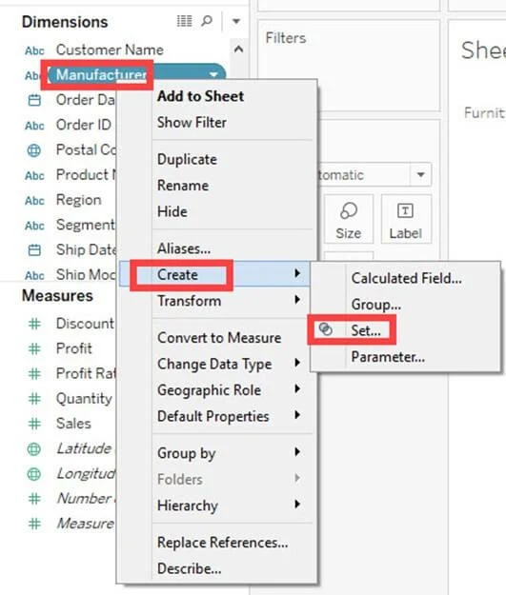
Sets
Definition: Sets are custom fields that define a subset of data based on specific conditions. They can be dynamic or static.
How to Create a Set:
Right-click a dimension in the Data pane, choose "Create Set," and define the criteria (e.g., based on sales amount).
Use Case: Sets are useful for comparative analysis, such as analyzing performance for a specific group of customers.
https://hevodata.com/learn/tableau-groups/

Slide 29
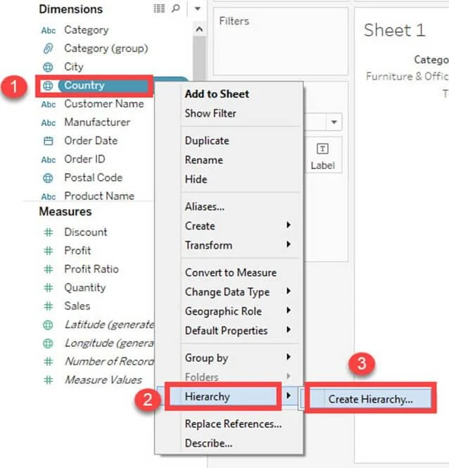
Hierarchies
Definition: Hierarchies allow you to organize dimensions into a multi-level structure, enabling drill-down capabilities in visualizations.
How to Create a Hierarchy:
In the Data pane, drag one dimension onto another to create a hierarchy. For example, you could create a hierarchy from Country > State > City.
Use Case: Hierarchies facilitate drilling down into data, such as starting with global sales and drilling down to specific regions and cities.
https://hevodata.com/learn/tableau-groups/

Slide 30
Summary
Sorting: Organizes data for better readability and insight.
Filters: Help to focus on specific data segments, enhancing analysis efficiency.
Groups, Sets, and Hierarchies: Tools for simplifying and structuring data for clearer analysis and exploration.
These features allow for effective data organization and simplification in Tableau, making your visualizations more impactful!

Slide 31
Learn Tableau Built-In and Custom Chart
Histograms, Heat maps, Tree maps, Bullet graphs, Axis Charts, Scatter Plots, Data Highlighter, Cross tabs, Motion charts, Bar charts, Box plots
Custom Charts :-Motion Chart ,Lolipop Chart ,Donut Chart ,Water fall Chart ,Funnel Chart ,Pareto Chart,Dual Combination Charts
How to Build KPI's
Built-In Charts https://www.edureka.co/blog/tableau-charts/
Histograms
Purpose: Display the distribution of a measure by grouping data into bins.
Use Case: Analyzing the frequency of sales amounts across different ranges.
Heat Maps
Purpose: Visualize data through color gradients, where the intensity of color represents the magnitude of the data.
Use Case: Showing sales performance across different regions and categories.
Bullet Graphs
Purpose: Show progress toward a goal or benchmark, combining features of a bar chart and a reference line.
Tree Maps
Purpose: Represent hierarchical data as nested rectangles, where the size of each rectangle reflects the measure.
Use Case: Displaying sales by category and sub-category.
Use Case: Tracking sales against a target for a specific period.
https://help.tableau.com/current/pro/desktop/en-us/dataview_examples.htm

Slide 32
5. Axis Charts
Purpose: Display data points along a continuous scale, useful for showing trends over time.
Use Case: Line charts showing monthly sales trends.
6. Scatter Plots
Purpose: Show relationships between two quantitative measures.
Use Case: Analyzing the correlation between advertising spend and sales.
7. Data Highlighter
Purpose: Allows users to highlight specific data points in a chart based on selections.
Use Case: Emphasizing a particular product or category in a sales report.
8. Cross Tabs
Purpose: Present data in a table format, facilitating easy comparison across dimensions and measures.
Use Case: A summary of sales by region and product category.
9. Motion Charts https://data-flair.training/blogs/tableau-motion-chart/
Purpose: Display data points that change over time, with animation to illustrate trends.
Use Case: Visualizing sales growth across multiple regions over several years.
https://help.tableau.com/current/pro/desktop/en-us/dataview_examples.htm

Slide 33
10.Bar Charts
Purpose: Represent categorical data with rectangular bars, where the length of the bar corresponds to the measure.
Use Case: Comparing total sales across different product categories.
11. Box Plots
Purpose: Show data distribution and identify outliers through quartiles.
Use Case: Analyzing sales data to identify trends and outliers.

Slide 34
Custom Charts
Motion Chart https://www.javatpoint.com/tableau-motion-chart
Similar to built-in motion charts but can be customized for specific use cases.
Lollipop Chart https://www.useready.com/blog/how-to-build-a-custom-lollipop-chart-in-tableau
Variation of a bar chart, using dots and lines for a cleaner look.
Use Case: Displaying product sales with a modern aesthetic.
Donut Chart https://community.tableau.com/s/question/0D54T00000C62HPSAZ/creating-donut-chart-in-tableau
A variation of a pie chart with a hole in the center, allowing for central labeling.
Use Case: Showing market share by product categories.
https://www.analyticsvidhya.com/blog/2021/02/how-to-create-donut-chart-tableau/
Waterfall Chart https://www.javatpoint.com/tableau-waterfall-chart
Displays cumulative totals and highlights the contributions of each segment.
Use Case: Visualizing how sales build from one period to the next.
Funnel Chart https://community.tableau.com/s/question/0D54T000019QYXKSA4/tableau-funnel-chart-help-creating-a-funnel-chart-using-multiple-calculated-fields
Represents stages in a process, often used in sales or conversion analysis.
Use Case: Showing the conversion rates through different stages of the sales pipeline.
Pareto Chart https://help.tableau.com/current/pro/desktop/en-us/pareto.htm
Combines a bar chart and a line chart to highlight the most important factors.
Use Case: Identifying the top reasons for defects in a quality control process.
Dual Combination Charts https://help.tableau.com/current/pro/desktop/en-us/qs_combo_charts.htm
Combines two different chart types (e.g., bar and line) to provide a comprehensive view of related metrics.
Use Case: Showing sales and profit margins together.

Slide 35
Building KPIs
Define Your KPIs: Identify the key metrics that are critical for measuring success (e.g., revenue growth, customer satisfaction).
Create Calculated Fields: Use calculated fields to define your KPIs if they require specific formulas (e.g., profit margin = Profit / Sales).
Choose the Right Visualization:
Use bullet graphs for progress toward targets.
Use KPI cards (text or gauge) for single metrics.
Format for Clarity:
Use colors (e.g., green for success, red for below target) to make KPIs easily interpretable.
Add reference lines or benchmarks to provide context.
Dashboard Integration: Place KPIs on a dashboard to provide an at-a-glance view of performance, alongside other visualizations for deeper insights.
By using these built-in and custom charts, along with effective KPI creation, you can create powerful visualizations and performance monitoring tools in Tableau!
https://help.tableau.com/current/pro/desktop/en-us/kpi.htm
https://blog.coupler.io/tableau-kpi-dashboard/
https://www.tableau.com/drive/kpi-calculations

Slide 36
Get Started with Calculations in Tableau
Table Calculations
Table calculations are transformations that are applied to the data in your visualization after it has been aggregated. They allow for dynamic calculations based on the structure of the visualization.
Key Features of Table Calculations:
Context-Dependent: They change based on the dimensions and measures present in the view.
Common Types:
Running Total: Cumulatively sums values over a specified dimension.
Percent of Total: Shows each value as a percentage of the total.
Difference: Calculates the difference between values in the view.
Moving Average: Averages values over a specified number of periods.
How to Create Table Calculations:
Add a Measure: Start by placing a measure in your view.
Select Table Calculation: Right-click the measure in the view, choose “Quick Table Calculation,” and select your desired calculation.
Customize: You can customize the calculation further through the "Edit Table Calculation" option.
Level of Detail-Fixed
Include,Exclude LOD
Basic calculations (a row-level calculation)
Level of Detail (LOD) expressions (fixed ,include, exclude -->,LOD calculations allow you to compute
values at the data source level and the visualization level.)
Table calculations
https://help.tableau.com/current/pro/desktop/en-us/calculations_calculatedfields_create.htm
https://mode.com/help/articles/cal-fields

Slide 37
https://help.tableau.com/current/pro/desktop/en-us/calculations_tablecalculations.htm
https://help.tableau.com/current/pro/desktop/en-us/calculations_tablecalculations_quick.htm
Functions
string
maths
date
if
case
Level of Detail(LOD)-
Fixed
Include,
Exclude
{include [City] , [Customer Name] : SUM([Profit]) }
{Fixed [City], [Customer Name] : SUM([Profit]) }
https://absentdata.com/tableau-function-list/
https://www.kdnuggets.com/2022/08/10-used-tableau-functions.html

Slide 38
Level of Detail (LOD) Expressions
LOD expressions allow for more granular control over the aggregation of data. They let you specify the level at which calculations are performed, regardless of the view’s structure.
Types of LOD Expressions:
INCLUDE
EXCLUDE
FIXED
Fixed LOD
Definition: Calculates a value using the specified dimensions, regardless of the dimensions in the view.
Syntax:
plaintext
{FIXED [Dimension1], [Dimension2]: AGGREGATE_FUNCTION([Measure])}
Use Case: To calculate a fixed value, such as total sales per region, regardless of any other filters applied to the view.
Example:
plaintext
{FIXED [Region]: SUM([Sales])}
This calculates the total sales for each region, ignoring any other dimensions in the view
Category-wise sales with different dimensions
Q. customer order frequency (histogram) https://www.youtube.com/watch?v=hTGRUkizGFM

Slide 39
.
Include LOD
Definition: Calculates a value using the dimensions in the view plus additional dimensions you specify.
Syntax:
plaintext
{INCLUDE [Additional Dimension]: AGGREGATE_FUNCTION([Measure])}
Use Case: To calculate a value at a more granular level than what’s shown in the view.
Example:
plaintext
{INCLUDE [Product]: AVG([Sales])}
This calculates the average sales per product, including it in the aggregation even if the product dimension isn’t directly in the view.
Exclude LOD
Definition: Calculates a value using the dimensions in the view, but excluding specified dimensions.
Syntax:
plaintext
{EXCLUDE [Dimension]: AGGREGATE_FUNCTION([Measure])}
Use Case: To aggregate values while ignoring certain dimensions.
Example:
plaintext
{EXCLUDE [Category]: SUM([Sales])}
This sums sales while excluding the Category dimension, giving a total across categories.
https://www.tutorialspoint.com/tableau/tableau_lod_expressions.htm

Slide 40
Summary
Table Calculations: Apply dynamic transformations based on the current view, providing insight based on context.
Fixed LOD: Allows you to calculate aggregates at a specified level, independent of the visualization.
Include LOD: Aggregates at a more detailed level, including additional dimensions.
Exclude LOD: Aggregates while excluding specified dimensions.

Slide 41
Optional things
Tableau - Operators
Tableau - Functions
Tableau - Numeric Calculations
Tableau - String Calculations
Tableau - Date Calculations
Tableau - Table Calculations
Tableau - LOD Expressions
Data Types in Tableau
Tableau Data Types :- Measures & Dimensions
Understand discrete v. continuous
Understand measure names and measure values
Understand generated fields - Calculated Fields, Parameters.
Assignment
https://www.javatpoint.com/tableau

Slide 42
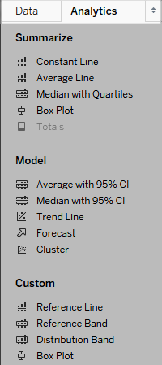
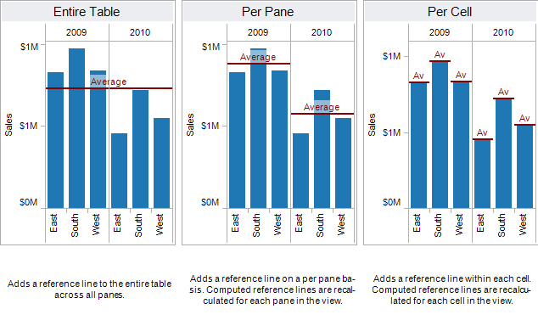
Analytics
Understand how to use -
Reference Lines, Reference Bands, Trend Lines,
Trend Model, Forecasting, Drag & Drop Analytics,
Box Plot, Reference distributions, Statistical summary card
https://help.tableau.com/current/pro/desktop/en-us/reference_lines.htm
https://help.tableau.com/current/pro/desktop/en-us/environ_workspace_analytics_pane.htm

Slide 43
Tableau Dashboard
Understand how to build dashboards
Understand Device Designer
Understand Dashboard Object
Understand how to create a drill down report
Understand how to utilize visual best practices for dashboard design
Understand Action Filters - URL, Highlight, Filter ,Parameter & Change set value
Understand publishing & sharing options (How to Publish Dashboard on Tableau Public)
https://app.mokkup.ai/dashboard

Slide 44
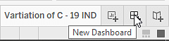
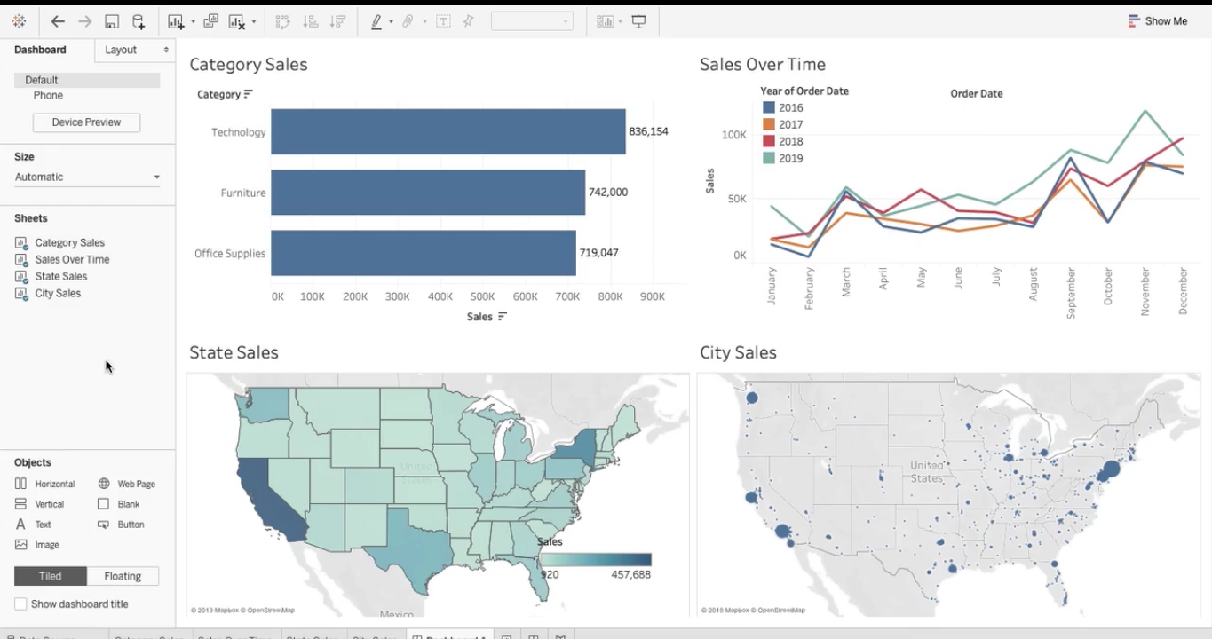
“Create New Dashboard
https://www.datacamp.com/tutorial/tableau-dashboard-tutorial
https://help.tableau.com/current/pro/desktop/en-us/dashboards_best_practices.htm
https://data-flair.training/blogs/tableau-dashboard/

Slide 45
Performance improvement of Dashboard
How dashboard performance can be improved Using AI with Tableau
https://www.tableau.com/blog/6-tips-make-your-dashboards-more-performant
https://www.simplilearn.com/tutorials/tableau-tutorial/tableau-dashboard

Slide 47
Project Refrence
https://www.youtube.com/watch?v=5uzB4z4iN0g
https://youtu.be/0tw-oAc5GDg?si=I_p6eRZf69IWvaEI --> Tableau Projects For Practice With Open-Source Files
https://youtu.be/7uwf1mA62zI?si=hkmY5Eaz5oE2VcVw -->Learn Tableau Basics in 1 Hour - With Healthcare Data 💊
https://github.com/codebasics/DataAnalysisProjects/tree/master/2_SalesInsightsTableau
INTERVIEW QUESTIONS
https://github.com/OBenner/data-engineering-interview-questions/blob/master/content/tableau.md
https://www.projectpro.io/article/tableau-interview-questions-and-answers/470
https://www.datacamp.com/blog/master-tableau-interview-questions
https://www.simplilearn.com/tableau-interview-questions-and-answers-article
https://www.testgorilla.com/blog/tableau-interview-questions/

Slide 48
extra topics
Tableau workflow.
Change the datatype
Apply Blend and Join for Customer, Customer Order, and Product details sheets to display Customer ID, Order ID, Product ID, and Product Name without any data loss.
Dataset Link: Product Dataset
Create a group of Policy numbers: P-10, P-11, P-12, P-13, P-14, P-15, P-16, and P17-P99 for Policy numbers starting with 10, 11, and so on up to 99.
Create a donut chart for incident severity
Create a bullet graph
Create a motion chart
Difference between Reference Line and Reference Band:
Highlight Action

Slide 49
📊 Tableau Actions – Options & Steps (with Demonstration)
🔹 What are Actions in Tableau?
Actions allow users to interact with dashboards by clicking, hovering, or selecting marks to trigger changes like filtering, highlighting, or navigation.
🔹 Types of Actions in Tableau
Filter Action
Highlight Action
URL Action
Go to Sheet Action
Change Parameter Action (advanced)
1️⃣ Filter Action (Most Common)
✅ Purpose
Filters data in one sheet based on selection in another sheet.
📌 Example
Click a Region → show only that region’s Sales.
🪜 Steps to Create Filter Action
Create at least two worksheets
Create a Dashboard
Go to Dashboard → Actions
Click Add Action → Filter
Set:
Source Sheet: Sheet you click
Target Sheet: Sheet to be filtered
Run action on: Select / Hover / Menu
Choose Clearing selection:
Show all values / Exclude all / Keep filtered
Click OK
✅ Now click on a chart → other chart updates

Slide 50
2️⃣ Highlight Action
✅ Purpose
Highlights related data instead of filtering.
📌 Example
Hover over a Category → highlight
matching records.
🪜 Steps
Dashboard → Actions
Add Action → Highlight
Choose:
Source Sheet
Target Sheet
Fields to highlight
Run on Hover or Select
Click OK
4️⃣ Go to Sheet Action
✅ Purpose
Navigate between sheets or dashboards.
📌 Example
Click summary chart → go to detailed sheet.
🪜 Steps
Dashboard → Actions
Add Action → Go to Sheet
Select:
Source Sheet
Target Sheet/Dashboard
Choose trigger
Click OK
3️⃣ URL Action
✅ Purpose
Opens a web page when clicking a mark.
📌 Example
Click Product → opens product website.
🪜 Steps
Dashboard → Actions
Add Action → URL
Enter:
URL (can use fields dynamically)
Choose trigger (Select / Menu)
Click OK

Slide 51
5️⃣ Action Options (Important for Exams)
Option | Meaning
Run action on | Select / Hover / Menu
Source Sheet | Sheet user interacts with
Target Sheet | Sheet affected
Clearing selection | What happens when deselected
Target Filters | Selected fields / All fields
🧪 How to Demonstrate in Lab / Viva
Create Bar Chart (Sales by Category)
Create Line Chart (Sales over Time)
Add both to a Dashboard
Apply Filter Action
Click bar → line chart changes
Explain: “This is a filter action triggered on selection”

